Slide 1
NFL Sports Betting Improvement
Brody Goettl, Garrett Krajnik, Ian Nie, Matt Minor

Slide 2
project
We created a program that predicts winners of 2024 NFL regular season games and creates a pie chart to show win percentages to improve betting.

Slide 3
Motivation
Our group is very interested in sports, and a big part of sports that has been expanding recently is the sports betting/gambling industry.
We all are NFL fans, so we decided to make a model for improving our NFL betting.

Slide 4
Results
88% (14/16) accuracy with the Packer and Vikings games
75% (12/16) accuracy with the Bears and Lions games

Slide 5
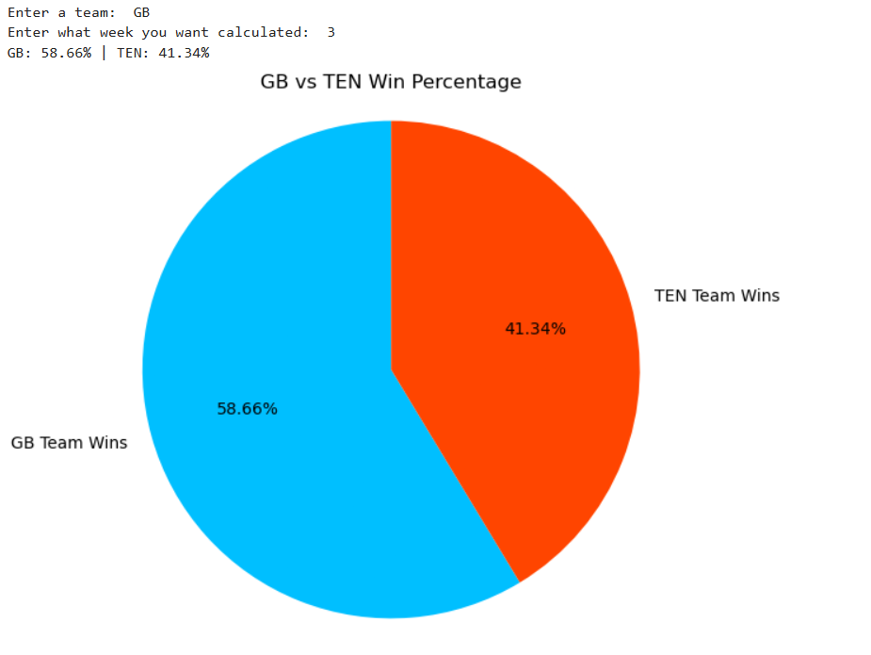
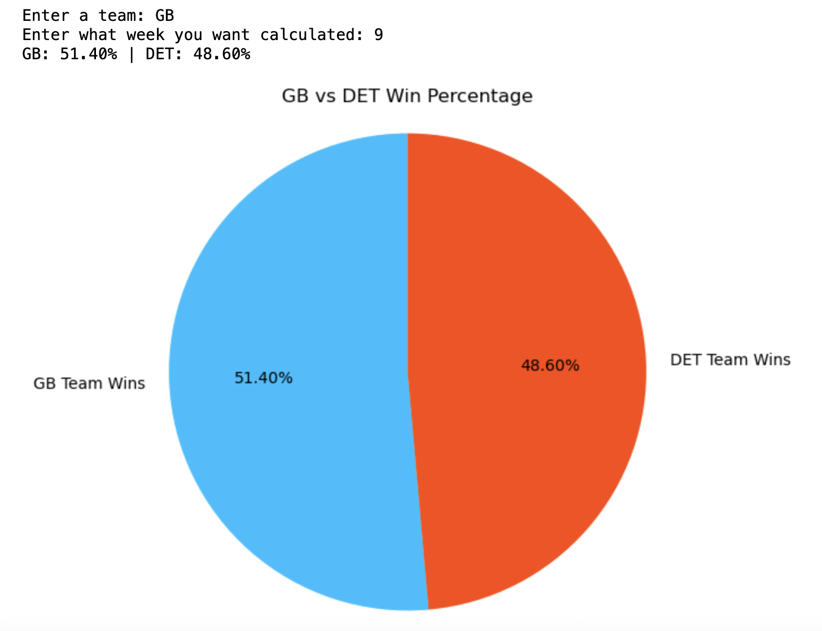
Results: CORRECT & INCORRECT

Slide 6
Methodology

Slide 7
Methodology: datasets
Took Datasets from Kaggle
Compared variables using linear regression graphs
Narrowed down variables in datasets
Created a Point System

Slide 8
Point System

Slide 9
Point System: offense
70 points for a touchdown
30 points for a field goal
10 points for an extra point
10 points for total of first downs
1 point per yard

Slide 10
Point System: Defense
70 points for a touchdown
50 points for interceptions
20 points for sacks

Slide 11
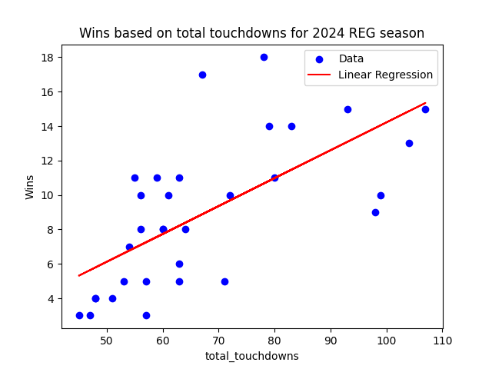
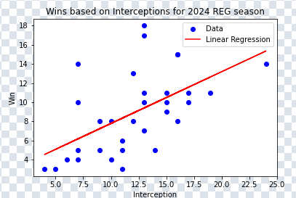
Point System: Graphs Kept

Slide 12
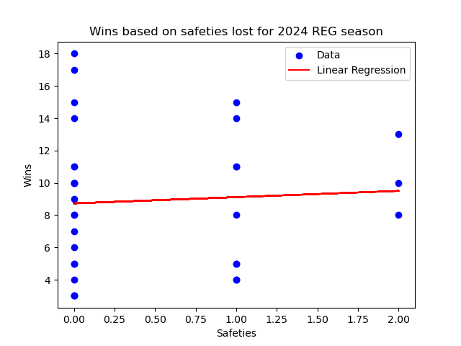
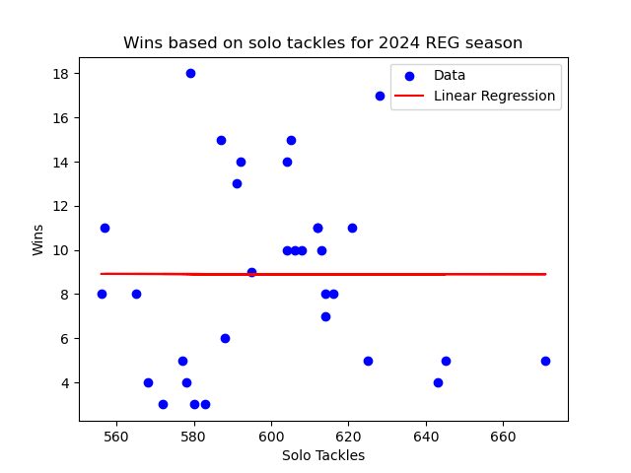
POINT SYSTEM: GRAPHS DISCARDED

Slide 13
Code

Slide 14
CoDe: Dependencies
OS version: Python 3.13 (Jupyter hub)
Libraries: Pandas, Numpy, matplotlib.pyplot, sys, seaborn

Slide 15
CoDe:DAta
NFL Predictor
Linear Regression Graph

Slide 16
CoDe: Edge Cases
Week 1: lack of evidence error
Bye week: producing error
Post season error

Slide 17
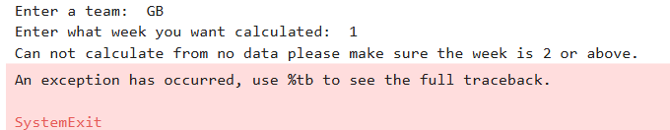
CoDe: Edge Cases
Week 1: lack of evidence error (boxes 3 and 4)

Slide 18
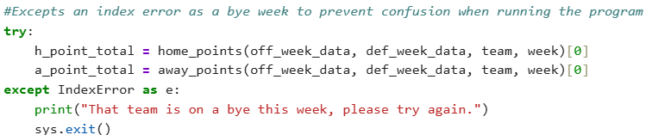
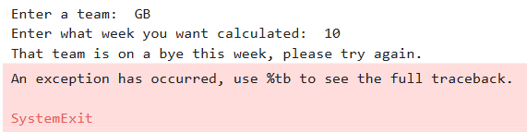
CoDe: Edge Cases
Bye week: producing error

Slide 19
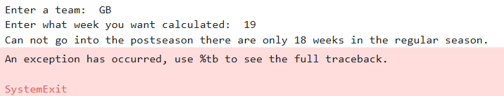
CoDe: Edge Cases
Post season error

Slide 20
Future Improvements

Slide 21
Future Improvements
Fix the problem of a bye week
Incorporate a momentum meter for in game predictions
Real-time data analysis
Predicting post-season
Injuries
The lions had just come off a bye week, and since bye weeks have no point total, they get a zero for last week. Green bay had their bye the following week, so they had more weeks to gain points and in turn had a higher point total only because they played more games.

Slide 22
THANK YOU
Any questions?

